Slide 1
Introduction to Automated Testing
Jess Chadwick

Slide 2
Precautions:
Semantics abound
Simple terms for clarity
Simple != dumb
No code
Concepts, not implementation

Slide 3
Fundamentals of Software Testing
Back to basics

Slide 4
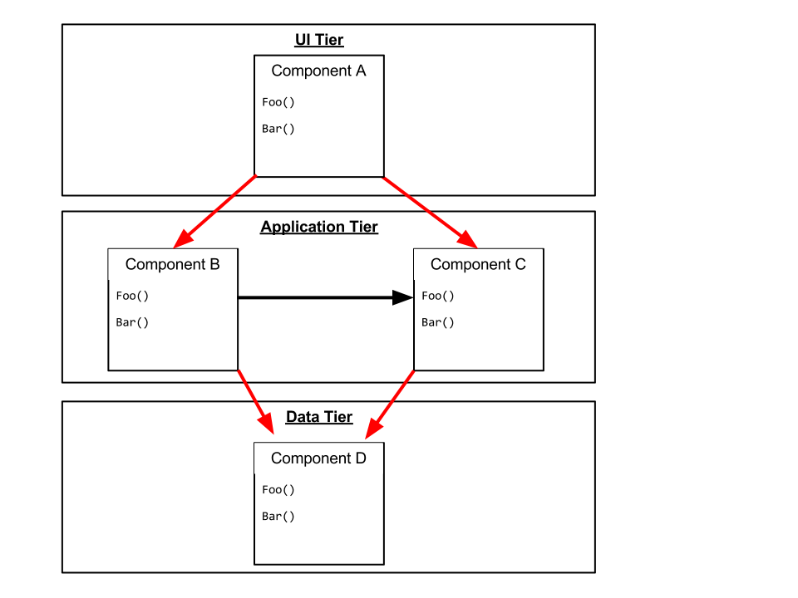

Slide 5
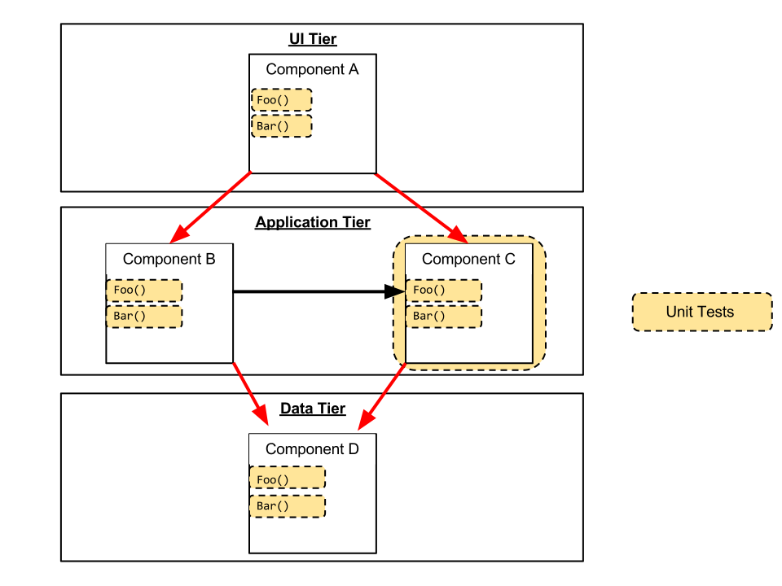

Slide 6
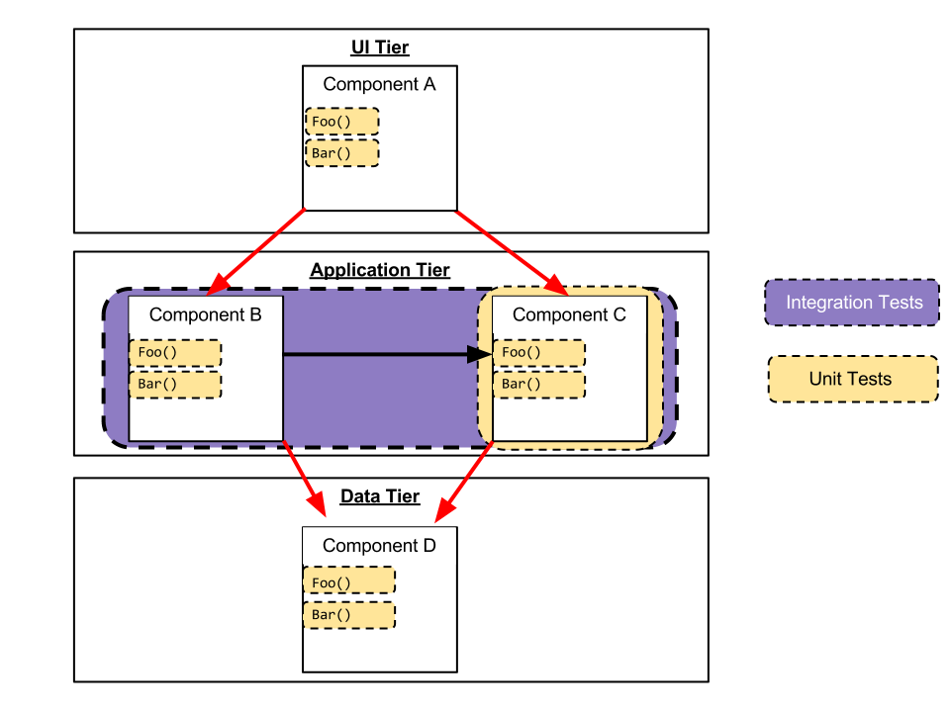

Slide 7
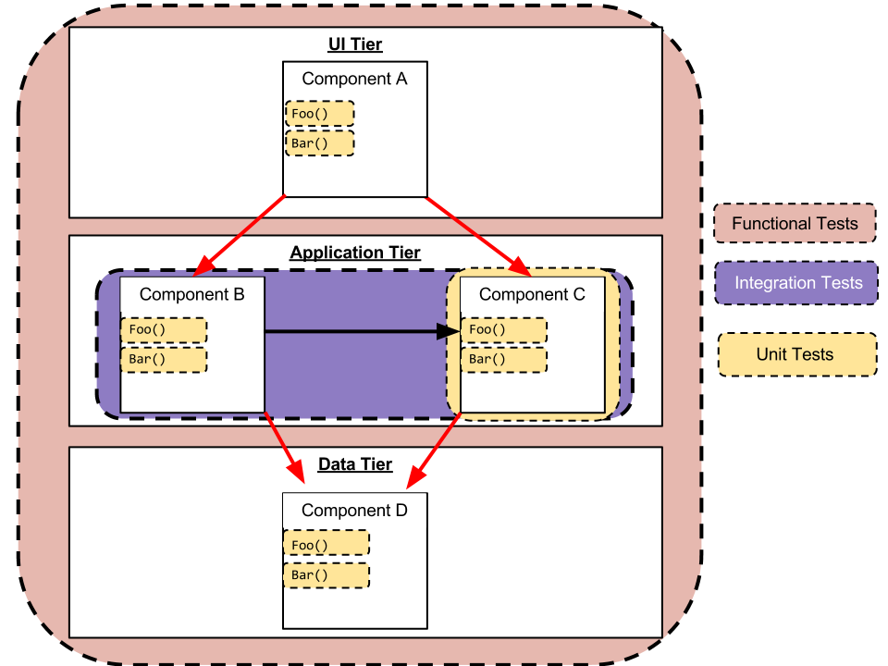

Slide 8
Automated Testing

Slide 9
Automated Tests…
Exercise the system without human intervention
Help ensure components work as designed
Help guard against regressions
Help expose how the system works
Documentation

Slide 10
What is Automated Testing?
Risk Mitigation

Slide 11
Automated Unit Testing
AKA “Unit Testing”

Slide 12
Automated Unit Tests are…
Fast
Deterministic
Independent
Repeatable
Focused
… Reliable

Slide 13
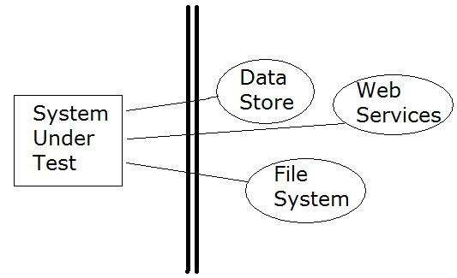
Unit tests…
Do not cross application / process boundaries

Slide 14
Integration Tests

Slide 15
Integration Tests…
Ensure two or more components work together
Often cross application / process boundaries
Are unreliable (non-deterministic)
They encourage ignoring failing tests
This is very bad!

Slide 16
Test Doubles

Slide 17
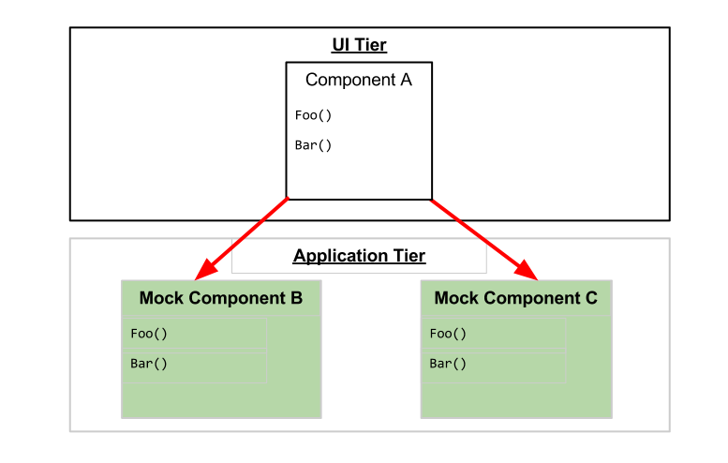
Test Doubles
Stand in for production components
Provide deterministic behavior
Provide control over testing environment

Slide 18
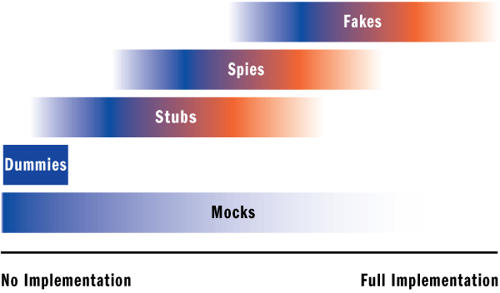
Source:
Unit Testing: Exploring The Continuum Of Test Doubles MSDN Magazine, September, 2007
Notes:
Roughly in order of implementation, from least (no) to full
Good article in this month’s MSDN Magazine discussing the difference

Slide 19
Automated Testing Best Practices

Slide 20
Best Practices
Prefer unit tests
Use test doubles to turn integration tests into unit tests
Run tests as often as possible
Use descriptive names
Target required/common scenarios and logic
80/20 rule

Slide 21
Best Practices
Build up the test environment from scratch
Yes, for every test!
Use Setup and Teardown methods for code reuse
Test Fixture (class) per component
Write tests to drive bug fixes
Create a test that fails because of the bug, then make the test pass by fixing the bug
Test code is code, too! Refactor appropriately.

Slide 22
Automated Testing Anti-Patterns

Slide 23
Automated Testing Anti-Patterns
No assertions
Just because it didn’t throw an exception doesn’t mean it works
Unclear / vague assertions
Depends on other tests to run previously
Logging / Console.WriteLine()
Only useful for manual evaluation – opposite of automated

Slide 24
Unit Testing Anti-Patterns
Testing multiple components at once
Slow
Usually an indication of crossing application / process boundaries
Depending on changes made by other tests or external interaction (non-deterministic)

Slide 25
Test-Driven Development
(TDD)

Slide 26
What is TDD?
“Test-Driven Development”
“Test-Driven Design”
A very overloaded and general term

Slide 27
A different way of thinking
Tests drive system design
“How am I going to test this?”
Helps drive loosely-coupled components
… and, ultimately, architecture

Slide 28
What is TDD?
“Write components that are easy to verify with automated tests”

Slide 29
Test-First Development
The ultimate in dogmatic test-driven development

Slide 30
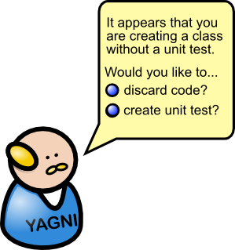
Test-First Development
No code can be written unless required to pass a failing test
Red - Green - Refactor

Slide 31
Test-First Development: Red - Green - Refactor
Red Broken Test
Green Bare minimum code to pass test
Refactor Modify to the minimalistic code so that it adheres to coding standards, etc.

Slide 32
TDD Pair Programming Game
Player 1: Write failing test
Player 2: Make failing test pass
Player 1: Refactor
… repeat!

Slide 33
Next Steps…

Slide 34
Try it out:
Write a few tests on your existing code
Code Katas osherove.com/tdd-kata-1 osherove.com/tdd-kata-2

Slide 35
Try it out
…and fail

